Slide 1
K-Means Algorithm
Paige Meyer
Numerical analysis Math 450

Slide 2
What is Clustering?

Slide 3
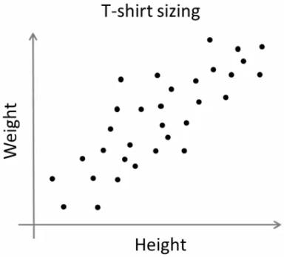

Slide 4
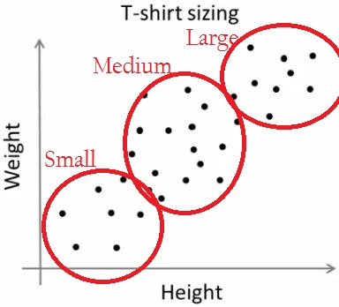

Slide 6
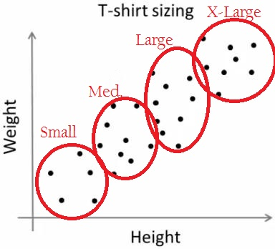
Notes:
The K-means Algorithm was Developed in 1955 – still widely used today

Slide 7

The k-means cost function
Input:
Finite set $S ⊂ ℝ^{d}, k ε ℤ^{+}$
Source: [3]
Notes:
We need an initial data set S, which has dimensions d. Also, since this is k-means clustering algorithm, we need k, the number of clusters, to group it into.

Slide 8

The k-means cost function
Input:
Finite set $S ⊂ ℝ^{d}, k ε ℤ^{+}$
Output:
Finite set $T ⊂ ℝ^{d}, \left|T\right|=k$
Source: [3]
Notes:
When we finish, we have the centroids of all of the clusters, T. T should be the number of clusters we wanted, k

Slide 9
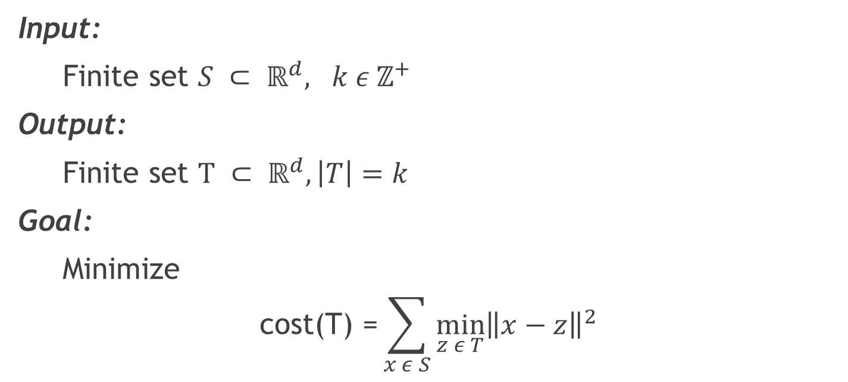
The k-means cost function
Input:
Finite set $S ⊂ ℝ^{d}, k ε ℤ^{+}$
Output:
Finite set $T ⊂ ℝ^{d}, \left|T\right|=k$
Goal:
Minimize
$$\text{cost}\text{(}\text{T}\text{) =}\sum_{x ε S}{\min_{z ε T}{{\left\|x−z\right\|}^{2}}}$$
Source: [3]
Notes:
We want to fit the data to the best of our abilities. This means, we want to minimize the distance of the data to the cluster. We can do this by choosing clusters, T, such that the mean of the cluster, z, minimizes the distance. Note: the difference is squared so that the if we have two data points, one above and the other below their difference to the mean doesn’t get canceled out. I will go more in-depth about this later on.
Note: Finding optimal k-means clustering is NP-hard even if k = 2

Slide 10

Voronoi Regions
[Def] The representatives T induce a Voronoi partition of $ℝ^{d}:$ a decomposition of $ℝ^{d}$ into $k$convex cells, each corresponding to some $z ∈ T$and containing the region of space whose nearest representative is $z$.
Source: [3]
Notes:
What this means is essentially we have data points, and group the map into different sections based on each point and which data point is closest to it.

Slide 11

Voronoi Regions
[Def] The representatives T induce a Voronoi partition of $ℝ^{d}:$ a decomposition of $ℝ^{d}$ into $k$convex cells, each corresponding to some $z∈ T$and containing the region of space whose nearest representative is $z$.
This partition induces an optimal clustering of the data set, $S =\bigcup_{z ∈ T}{C_{z}}$, where
$C_{z} = \left\{ x ∈ S : the closest representative of x is z\right\}$.
Source: [3]
Notes:
$S =\bigcup_{z ∈ T}{C_{z}}$ means all the points in the data set S are represented in some cluster $C_{z}$. Also, for each point, it belongs the the cluster $C_{z}$ which it is closest to the centroid.

Slide 12

Single Cluster
A single cluster C is assigned representative z. The cost is then
$$cost\left(T\right)=\sum_{x ε C_{n}}{{\left\|x −z\right\|}^{2}}$$
Which is minimized when z is the mean of the cluster.
Source: [3]
Notes:
We will do a simple case first, a single cluster. The cost associated with the cluster is simply the sum of the distances between each data point and the representative of the cluster (which we use to be the center).

Slide 13
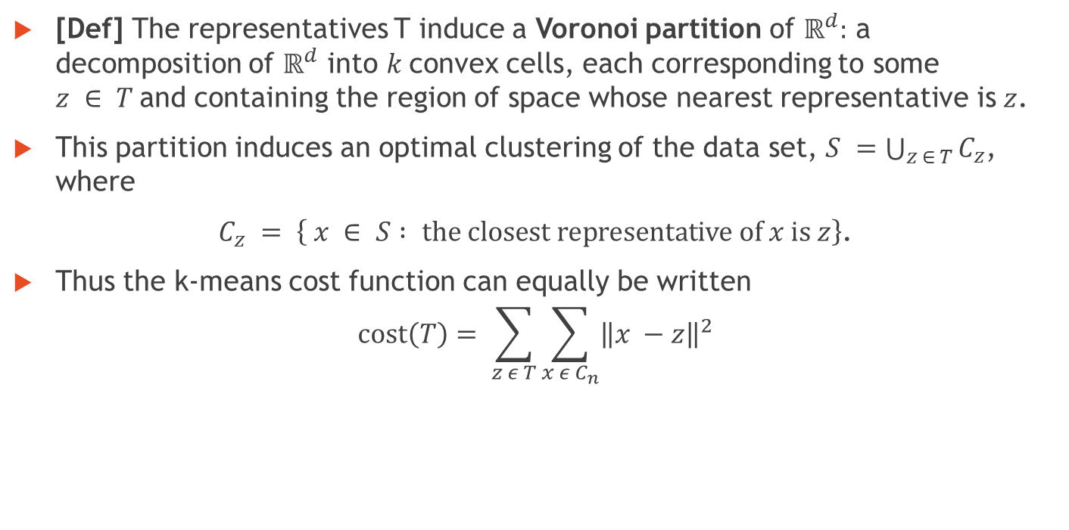
Voronoi Regions
[Def] The representatives T induce a Voronoi partition of $ℝ^{d}:$ a decomposition of $ℝ^{d}$ into $k$convex cells, each corresponding to some $z ∈ T$and containing the region of space whose nearest representative is $z$.
This partition induces an optimal clustering of the data set, $S =\bigcup_{z ∈ T}{C_{z}}$, where
$C_{z} = \left\{ x ∈ S : the closest representative of x is z\right\}$.
Thus the k-means cost function can equally be written
$$cost\left(T\right)= \sum_{z ε T}{\sum_{x ε C_{n}}{{\left\|x −z\right\|}^{2}}}$$
Source: [3]
Notes:
Thus, the cost function sums the distance from the centroid for all points in each cluster $C_{z}$. Then it takes those sums and sums the distances over all clusters. Thus, in order to create the best partition, we want to minimize the cost function.

Slide 14
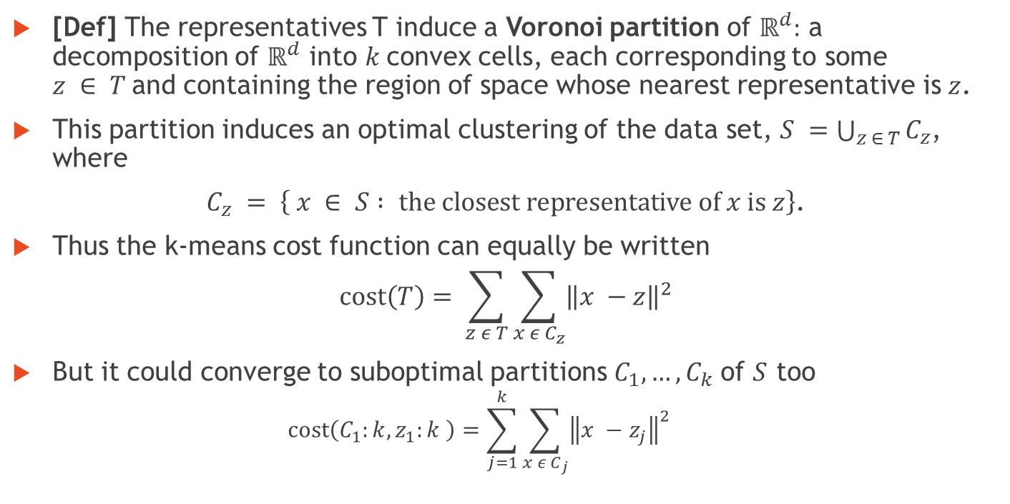
Voronoi Regions
[Def] The representatives T induce a Voronoi partition of $ℝ^{d}:$ a decomposition of $ℝ^{d}$ into $k$convex cells, each corresponding to some $z ∈ T$and containing the region of space whose nearest representative is $z$.
This partition induces an optimal clustering of the data set, $S =\bigcup_{z ∈ T}{C_{z}}$, where
$C_{z} = \left\{ x ∈ S : the closest representative of x is z\right\}$.
Thus the k-means cost function can equally be written
$$cost\left(T\right)= \sum_{z ε T}{\sum_{x ε C_{z}}{{\left\|x −z\right\|}^{2}}}$$
But it could converge to suboptimal partitions $C_{1}, …, C_{k}$ of $S$ too
$$cost\left(C_{1}:k, z_{1}:k \right)=\sum_{j=1}^{k}{\sum_{x ε C_{j}}{{\left\|x −z_{j}\right\|}^{2}}}$$
Source: [3]
Notes:
One thing to note is that not all some data points may go to one cluster instead of another. Thus, squeezing out one cluster. This means the data converged to a suboptimal solution because more clusters means less distance between centroids.

Slide 15

Lemma 1
For any set $C ⊂ ℝ^{d}$and any $z ⊂ ℝ^{d}$,
$$cost\left(C, z\right)=cost\left(C, mean(C)\right)+ \left|C\right|∗ {\left\|z −mean\left(C\right)\right\|}^{2}$$
Source: [3]
Notes:
Follows from a generic bias-variance decomposition of random vectors.
Contrast this with the case of k-center, where there is no closed-form expression for the optimal center of a cluster.

Slide 16

Lemma 2
Let $X ε ℝ^{d}$ be any random variable. For any $z ε ℝ^{d}$,
$𝔼{\left\|X−z\right\|}^{2}$ = $𝔼{\left\|X − 𝔼X\right\|}^{2}+ {\left\|z−𝔼X\right\|}^{2}$
Source: [3]

Slide 17

Lemma 2
Let $X ε ℝ^{d}$ be any random variable. For any $z ε ℝ^{d}$,
$𝔼{\left\|X−z\right\|}^{2}$ = $𝔼{\left\|X − 𝔼X\right\|}^{2}+ {\left\|z−𝔼X\right\|}^{2}$
proof
$$𝔼{\left\|X − 𝔼X\right\|}^{2}+ {\left\|z−𝔼X\right\|}^{2}$$
Source: [3]
Notes:
For the proof, we will start with one side of the equality, and try to get the other side.

Slide 18

Lemma 2
Let $X ε ℝ^{d}$ be any random variable. For any $z ε ℝ^{d}$,
$𝔼{\left\|X−z\right\|}^{2}$ = $𝔼{\left\|X − 𝔼X\right\|}^{2}+ {\left\|z−𝔼X\right\|}^{2}$
proof
$$𝔼{\left\|X − 𝔼X\right\|}^{2}+ {\left\|z−𝔼X\right\|}^{2}$$
$$= 𝔼\left[{\left\|X\right\|}^{2}+{\left\|𝔼X\right\|}^{2} −2X∗𝔼X\right]+ \left[{\left\|z\right\|}^{2}+ {\left\|𝔼X\right\|}^{2}−2z∗𝔼X\right]$$
Source: [3]
Notes:
This multiplies out the square.

Slide 19

Lemma 2
Let $X ε ℝ^{d}$ be any random variable. For any $z ε ℝ^{d}$,
$𝔼{\left\|X−z\right\|}^{2}$ = $𝔼{\left\|X − 𝔼X\right\|}^{2}+ {\left\|z−𝔼X\right\|}^{2}$
proof
$$𝔼{\left\|X − 𝔼X\right\|}^{2}+ {\left\|z−𝔼X\right\|}^{2}$$
$$= 𝔼\left[{\left\|X\right\|}^{2}+{\left\|𝔼X\right\|}^{2} −2X∗𝔼X\right]+ \left[{\left\|z\right\|}^{2}+ {\left\|𝔼X\right\|}^{2}−2z∗𝔼X\right]$$
$$= 𝔼{\left\|X\right\|}^{2}+{\left\|𝔼X\right\|}^{2} −2𝔼X∗𝔼X+{\left\|z\right\|}^{2}+ {\left\|𝔼X\right\|}^{2}−2z∗𝔼X$$
Source: [3]
Notes:
Distributing the expected value

Slide 20

Lemma 2
Let $X ε ℝ^{d}$ be any random variable. For any $z ε ℝ^{d}$,
$𝔼{\left\|X−z\right\|}^{2}$ = $𝔼{\left\|X − 𝔼X\right\|}^{2}+ {\left\|z−𝔼X\right\|}^{2}$
proof
$$𝔼{\left\|X − 𝔼X\right\|}^{2}+ {\left\|z−𝔼X\right\|}^{2}$$
$$= 𝔼\left[{\left\|X\right\|}^{2}+{\left\|𝔼X\right\|}^{2} −2X∗𝔼X\right]+ \left[{\left\|z\right\|}^{2}+ {\left\|𝔼X\right\|}^{2}−2z∗𝔼X\right]$$
$$= 𝔼{\left\|X\right\|}^{2}+{\left\|𝔼X\right\|}^{2} −2𝔼X∗𝔼X+{\left\|z\right\|}^{2}+ {\left\|𝔼X\right\|}^{2}−2z∗𝔼X$$
$$= 𝔼{\left\|X\right\|}^{2}+{\left\|z\right\|}^{2}−2z∗𝔼X$$
Source: [3]
Notes:
Canceling the two ${\left\|𝔼X\right\|}^{2} and the −2𝔼X∗𝔼X.$

Slide 21
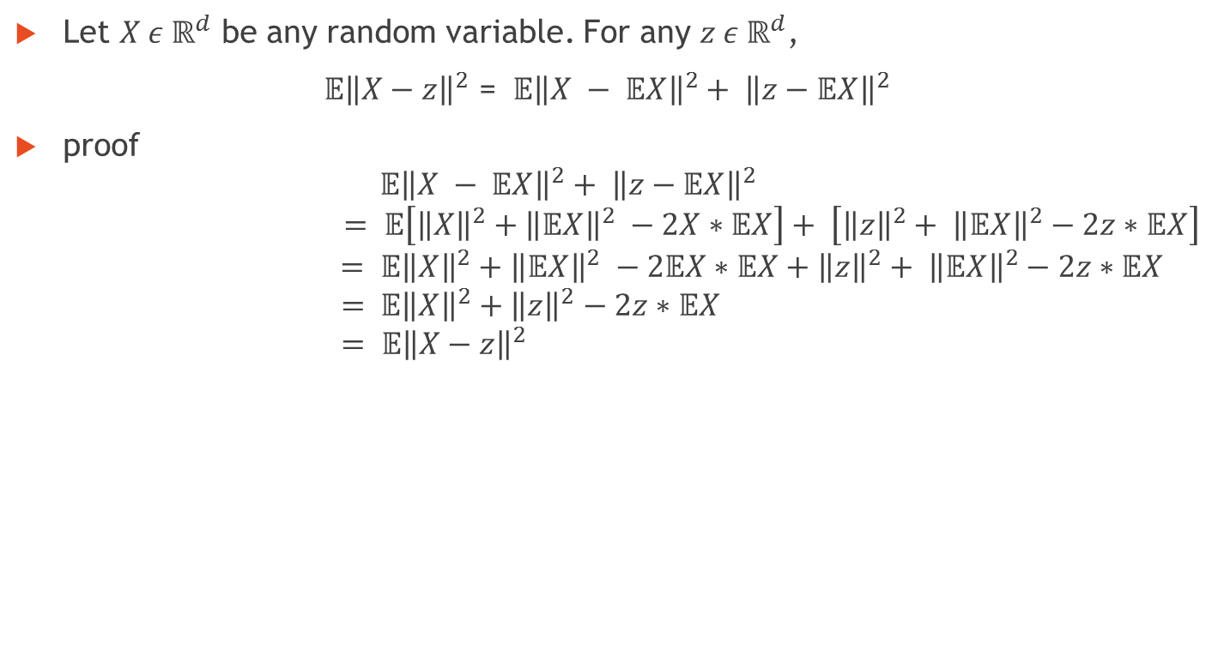
Lemma 2
Let $X ε ℝ^{d}$ be any random variable. For any $z ε ℝ^{d}$,
$𝔼{\left\|X−z\right\|}^{2}$ = $𝔼{\left\|X − 𝔼X\right\|}^{2}+ {\left\|z−𝔼X\right\|}^{2}$
proof
$$𝔼{\left\|X − 𝔼X\right\|}^{2}+ {\left\|z−𝔼X\right\|}^{2}$$
$$= 𝔼\left[{\left\|X\right\|}^{2}+{\left\|𝔼X\right\|}^{2} −2X∗𝔼X\right]+ \left[{\left\|z\right\|}^{2}+ {\left\|𝔼X\right\|}^{2}−2z∗𝔼X\right]$$
$$= 𝔼{\left\|X\right\|}^{2}+{\left\|𝔼X\right\|}^{2} −2𝔼X∗𝔼X+{\left\|z\right\|}^{2}+ {\left\|𝔼X\right\|}^{2}−2z∗𝔼X$$
$$= 𝔼{\left\|X\right\|}^{2}+{\left\|z\right\|}^{2}−2z∗𝔼X$$
$$= 𝔼{\left\|X−z\right\|}^{2}$$
Source: [3]
Notes:
Since the expected value of the X, means the mean, we just substitute z in for EX.

Slide 22

Lemma 2 (cont.)
Applying Lemma 2 to Lemma 1 by letting X denote a uniform random draw from cluster C.
$$𝔼{\left\|X−z\right\|}^{2}= \sum_{x ∈ C}{\frac{1}{\left|C\right|}{\left\|x−z\right\|}^{2}=\frac{1}{\left|C\right|}cost(C,z)}$$
and
$$𝔼{\left\|X−𝔼X\right\|}^{2}=\frac{1}{\left|C\right|}cost(C, cost(C))$$
Source: [3]

Slide 23
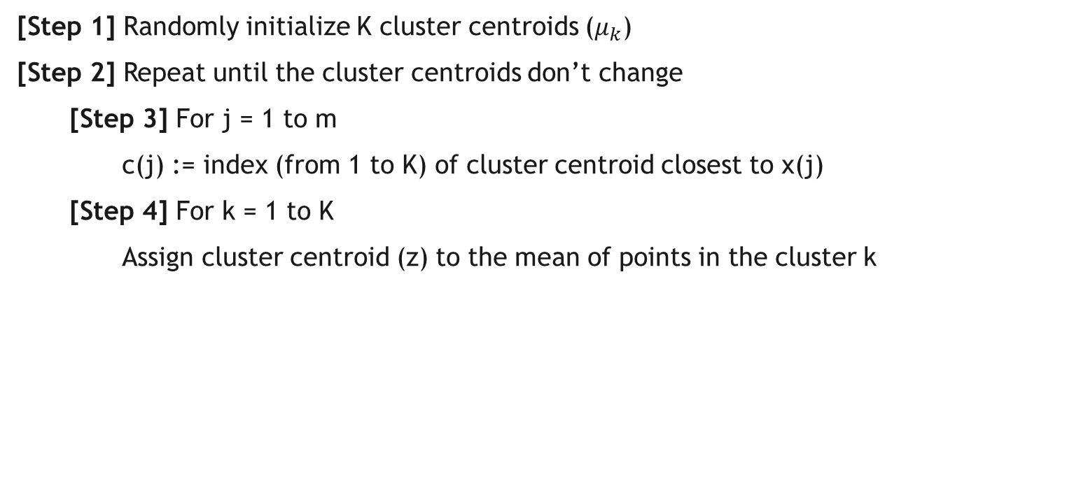
Algorithm
[Step 1] Randomly initialize K cluster centroids ($μ_{k}$)
[Step 2] Repeat until the cluster centroids don’t change
[Step 3] For j = 1 to m
c(j) := index (from 1 to K) of cluster centroid closest to x(j)
[Step 4] For k = 1 to K
Assign cluster centroid (z) to the mean of points in the cluster k
Source: [2]
Notes:
Step 3 – Assign data to clusters based on the data that is closest to it
Step 4 – Update centroids of clusters

Slide 24
Bibliography
https://msu.edu/~ashton/classes/866/papers/2010_jain_kmeans_50yrs__clustering_review.pdf
https://www.coursera.org/learn/machine-learning/lecture/93VPG/k-means-algorithm
https://cseweb.ucsd.edu/~dasgupta/291-geom/kmeans.pdf
http://mathworld.wolfram.com/VoronoiDiagram.html

